Slide 1
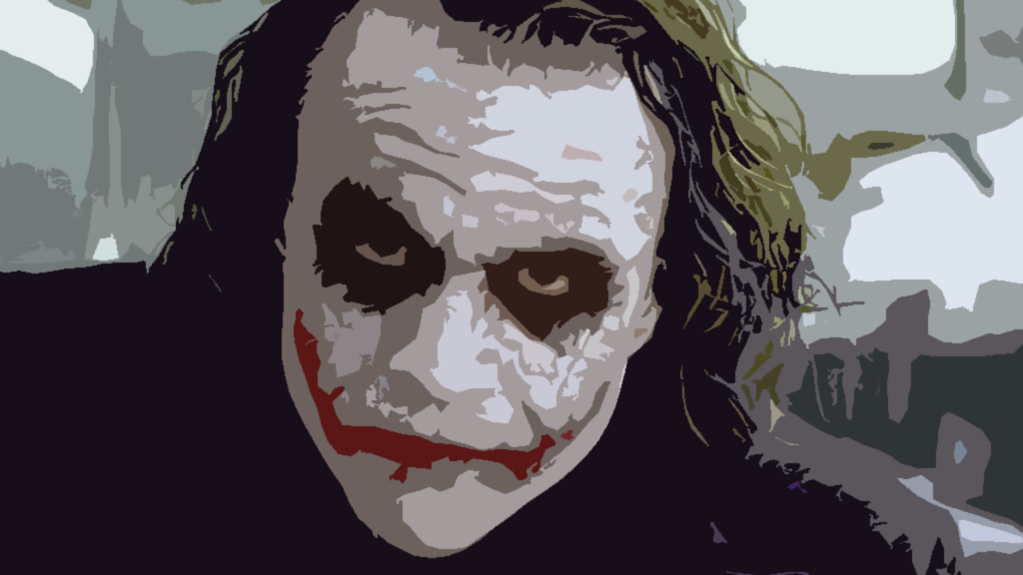
The Joker. The perfect Villain
Ethan Jerla | Lily Anzaldua

Slide 2
Thesis
The Joker is a chaotic genius, who’s physiological torment has cemented his legacy as the greatest villain of all time. He’s a staple in pop culture as an “embodiment of chaos”. The lasting impact he has on both his victims and fans of the Batman series is a testament to his deeper terror he instills.

Slide 3
Evidence
Quote: “Why so serious?” from The Dark Knight - This phrase encapsulates his philosophy of embracing chaos and challenging societal norms
Character Trait: The Joker’s bipolar traits show in his intricate schemes and his blend of dark humor with brutality
Cultural Impact: Heath Ledger’s portrayal on the Joker is a staple in pop culture and had made the Joker synonymous with mental brutality and societal disorder

Slide 4
Conclusion
The Joker’s chaotic and deep psychological complexity and cultural resonance make him an unparalleled villain. His monomaniacal and psychotic personality has led him to terrorize many, along with his uncanny personality and very dark humor. Combining these traits makes the Joker a very twisted and dark individual with a very well know track record of evil.
This makes him the perfect Villain

